Slide 1




(21CC505PC) SOFTWARE ENGINEERING
UPPAL CAMPUS
NARAYANGUDA
IBRAHIMPATNAM
LAB EXERCISE - 1
Introduction to SE lab
INSTALLATION OF STARUML, GIT BASH AND
GITHUB ACCOUNT CREATION & INTRODUCTION

Slide 2
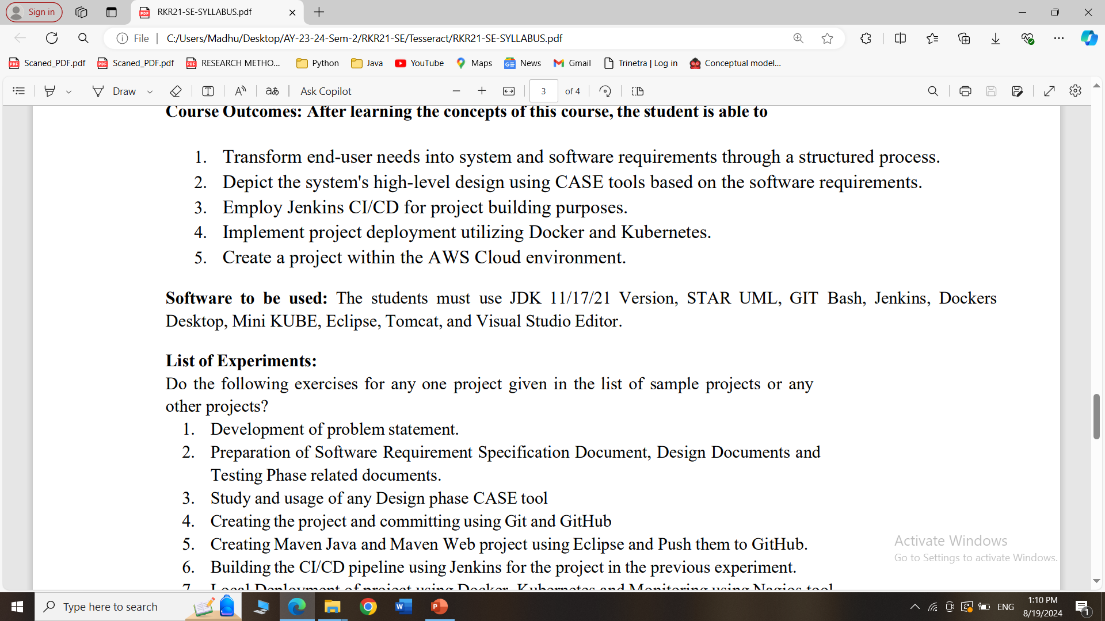
SYLLABUS

Slide 3
What is the use of STARUML?
StarUML is a software tool used to create diagrams that help in designing and understanding complex systems, especially in software development.
It allows you to visually map out how different parts of a system or application will work together, making it easier to plan, communicate, and build the system effectively.
Think of it as a drawing tool for software engineers to sketch out their ideas.

Slide 4
Installation of star UML: Note:- Screenshots are must for each and every step and need to be uploaded into tessallator
Step:-1
Download and install star UML from https://staruml.io/
Step:-2
Click on download for windows button based on your system architecture
Step:-3
Install the downloaded star UML software
Step:-4
Explore with tool bar option

Slide 5
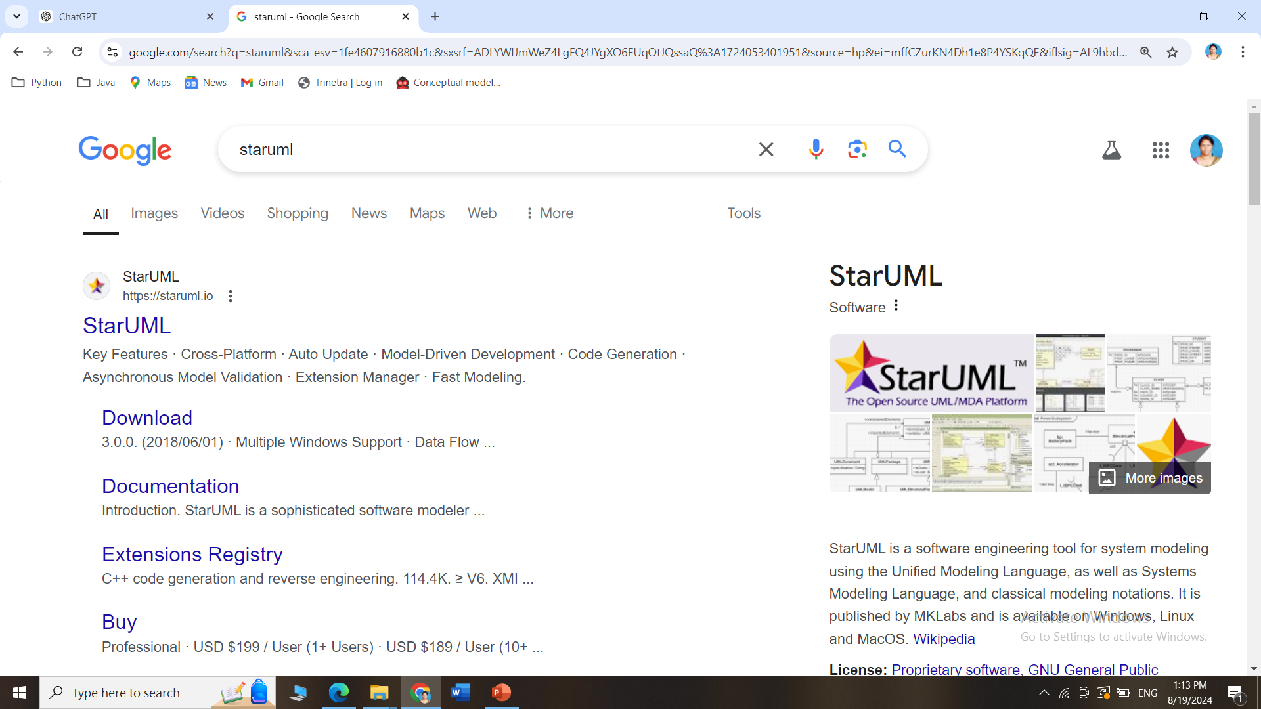
How to install STARUML
Search for StarUML in Google and Click on the official link

Slide 6
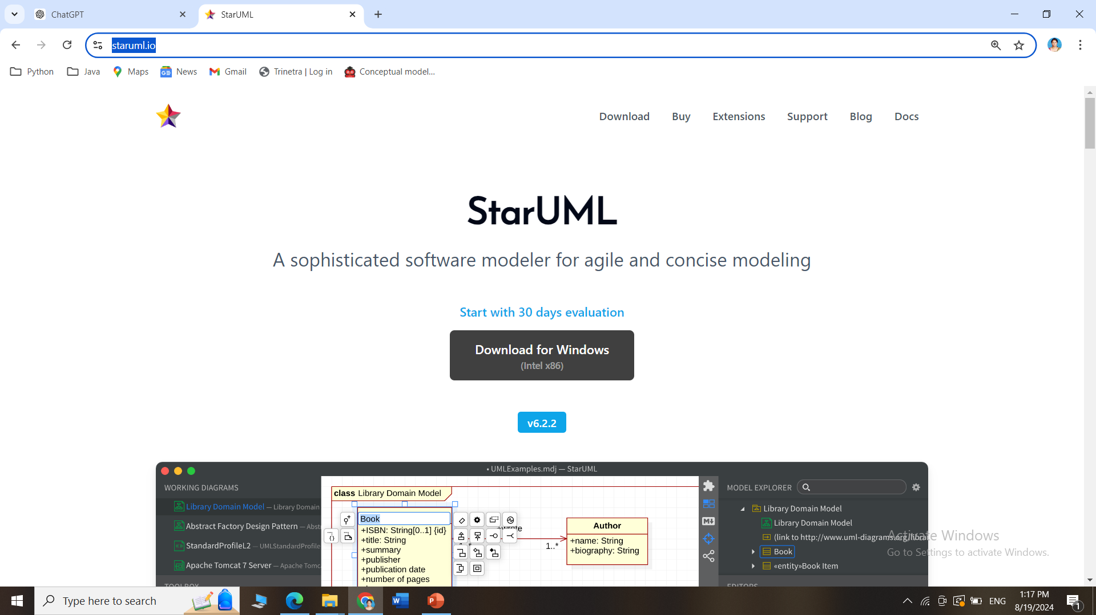
How to install STARUML
Go this site https://staruml.io/ and download StarUML for Windows/Mac

Slide 7
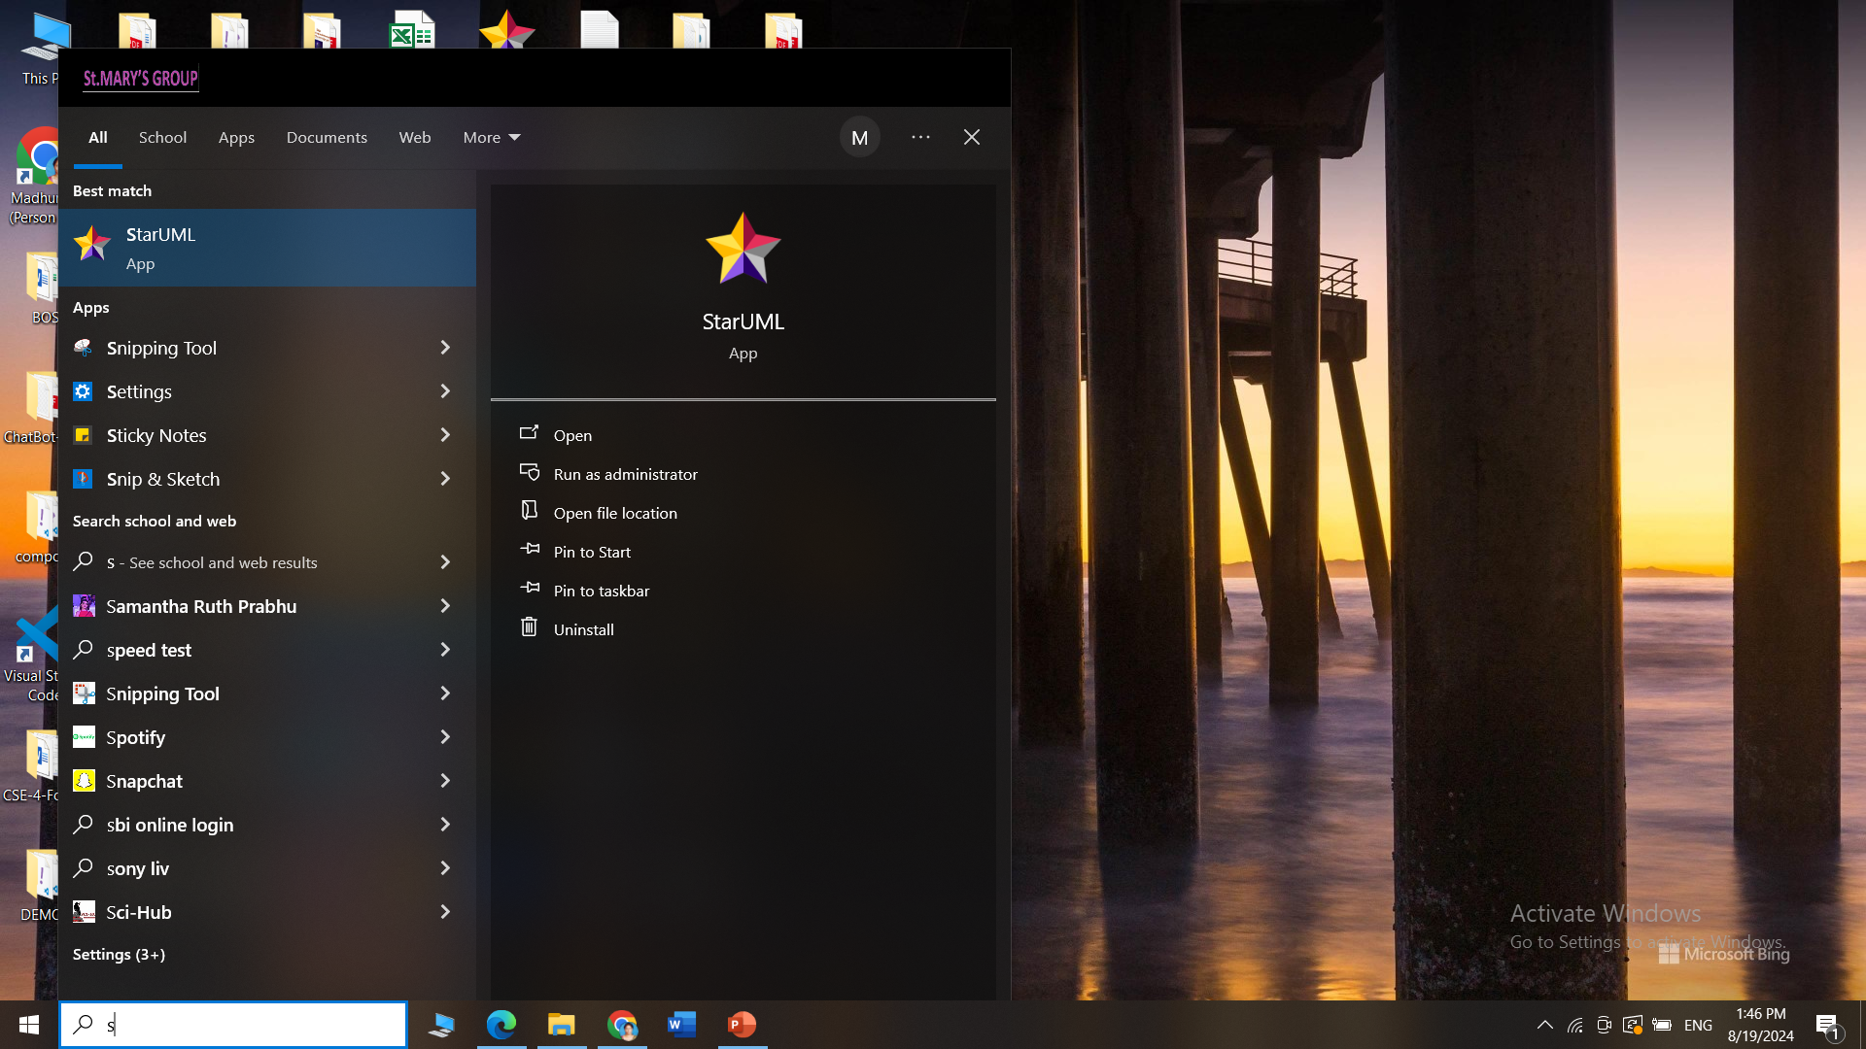
How to install STARUML
StarUML interface after installation

Slide 8
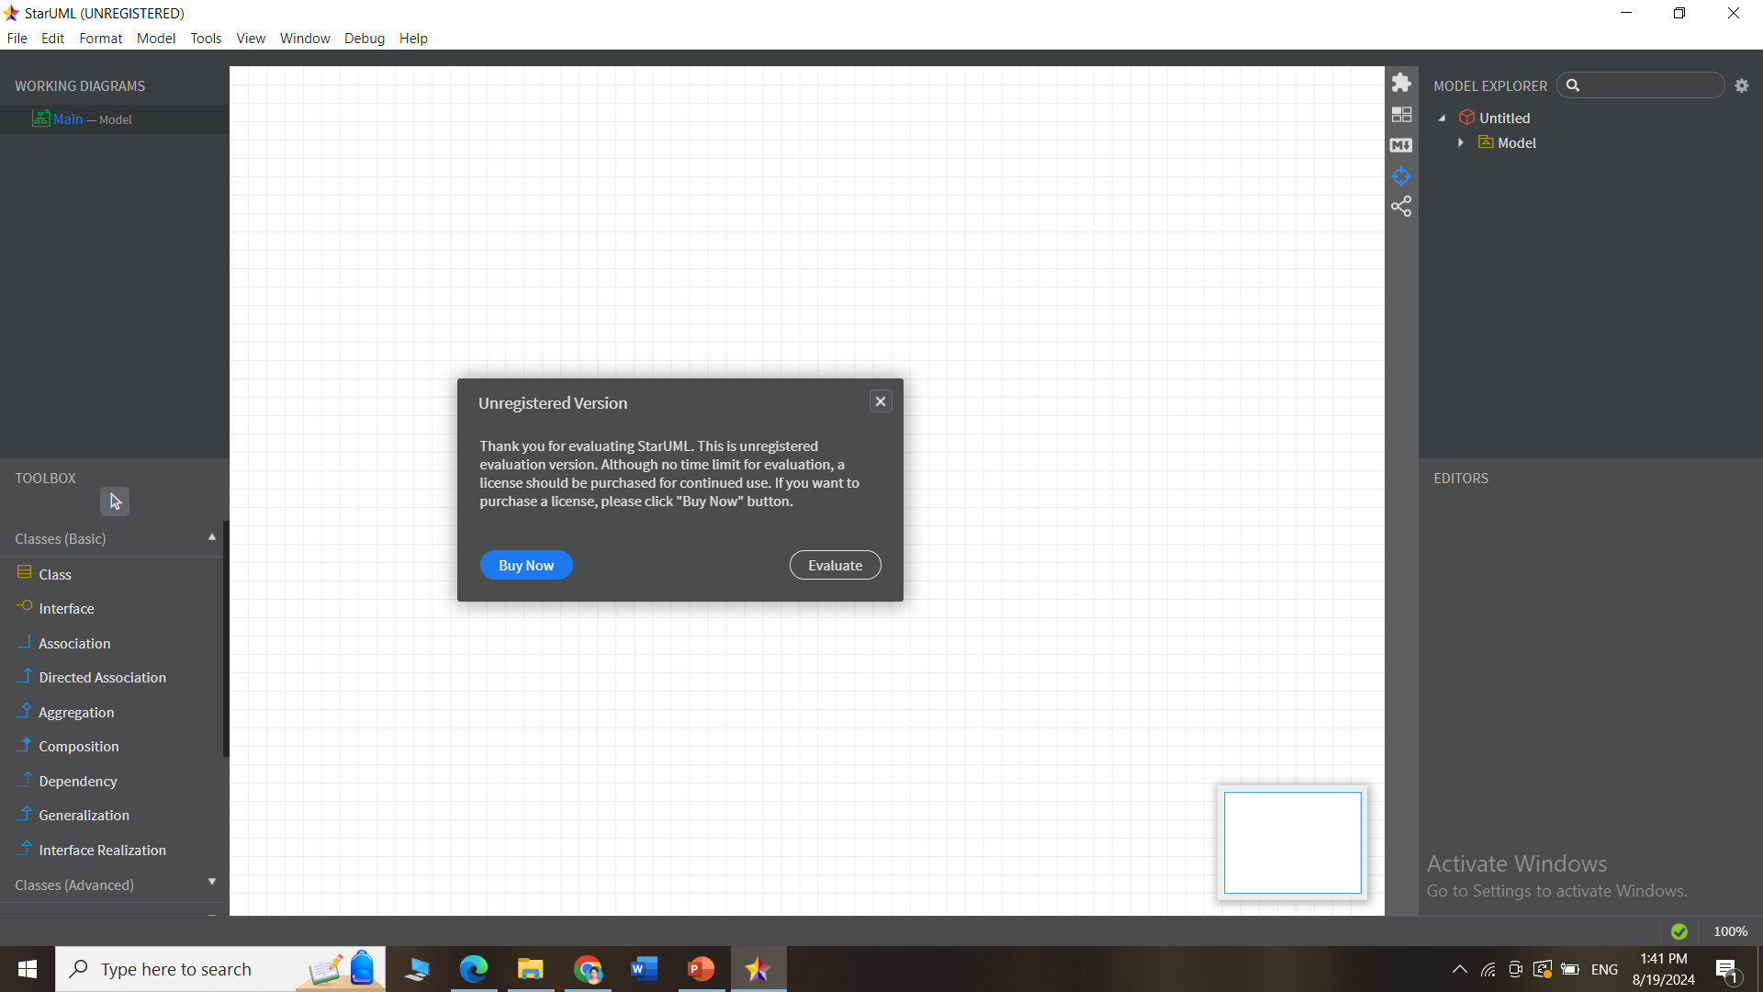
How to install STARUML
StarUML interface after installation

Slide 9
Installation of Git-SCM:
Step:-1
Download and install Git from the https://git-scm.com/
Step:-2
Select the Git software for the required OS
Step-3
Install the downloaded Git software
Step:-4
While installing select the option Use Git from Git Bash only option and click Next.
Step:-5
You will now find the Git Bash after successful installation
Note:- Screenshots are must for each and every step and need to be uploaded into tessallator

Slide 10
What is the use of GITBASH?
Git Bash is an application that lets you use Git commands on your computer.
Git: A tool for tracking changes in files, mainly used for managing code in software projects.
Git is a DevOps tool used for source code management
It is a free and open-source version control system used to handle small to very large projects efficiently.
Bash: A command-line tool that allows you to type in commands to perform various tasks on your computer.
Purpose:
Git Bash combines Git and Bash, so you can easily manage your code and use commands to work with files and projects. It helps in tracking the changes and collaborating with others on coding projects.

Slide 11
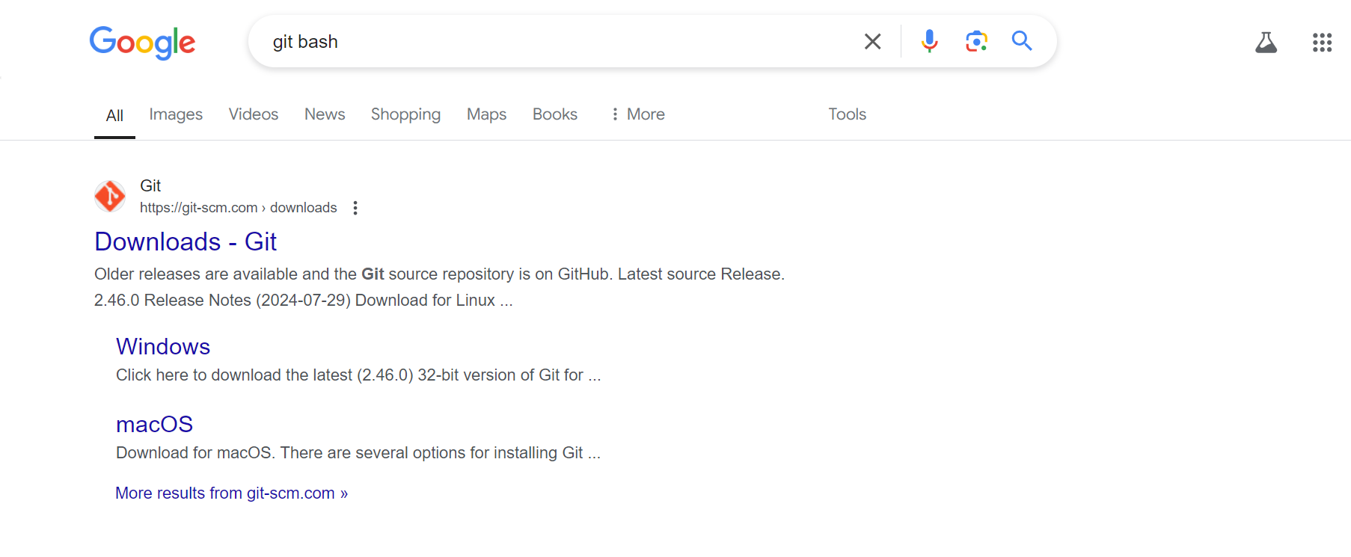
How to install Git
Search for git bash in Google and Click on the official link

Slide 12
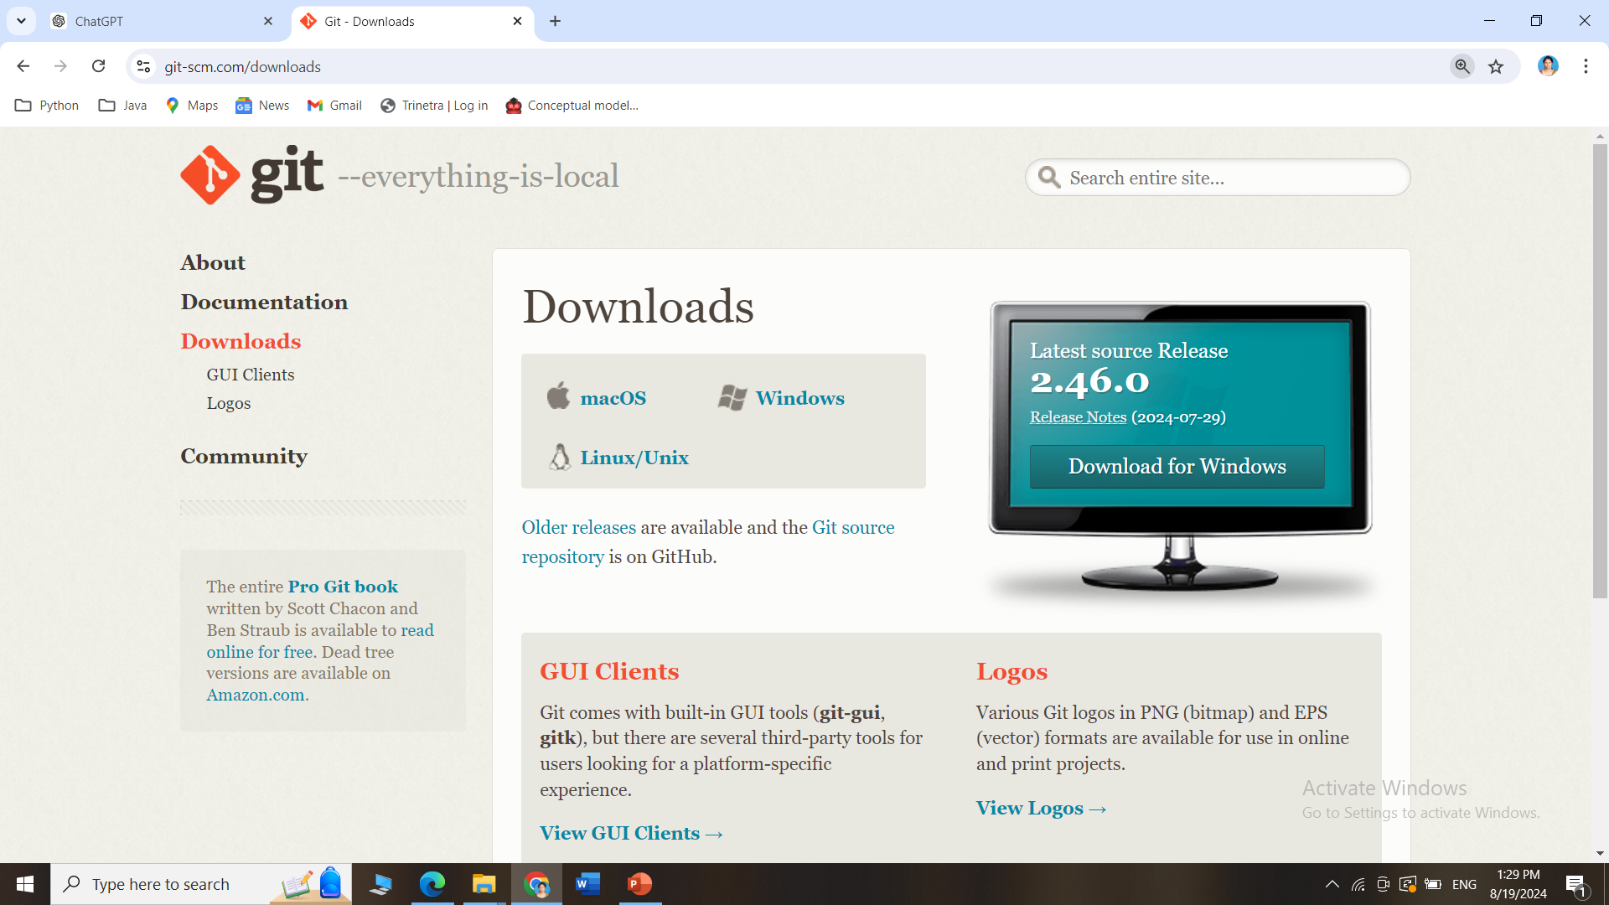
How to install GitBash
Go this site https://git-scm.com/downloads and download Git for Windows/Mac

Slide 13
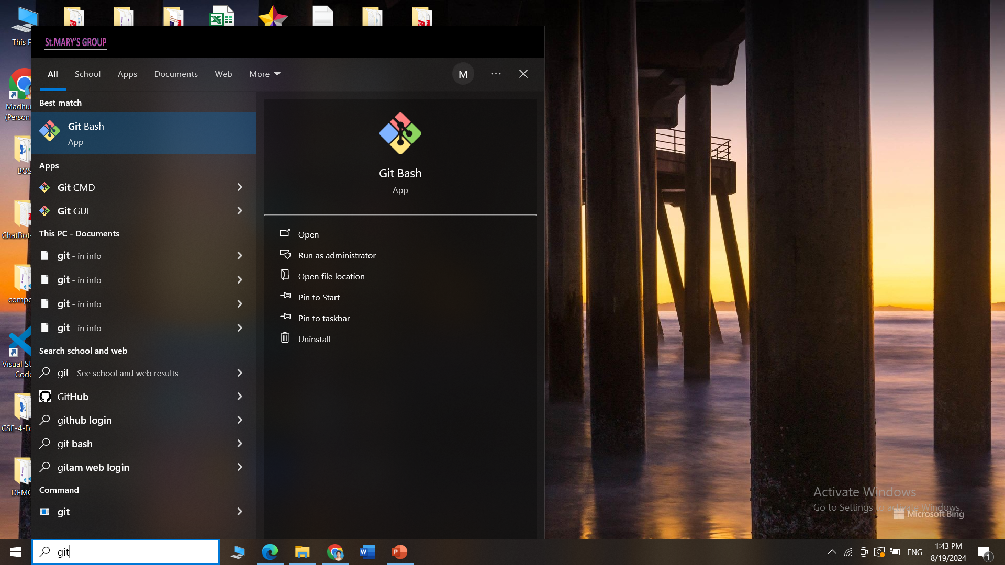
How to install Git
GitBash interface after installation

Slide 14
Git
Git is the most popular option and has become synonymous with "Software Configuration Management (SCM) “.
Git is used for software projects of any size, making it a popular option for startups, enterprise, and everything in between
Goal : To track changes in source code during software development

Slide 15
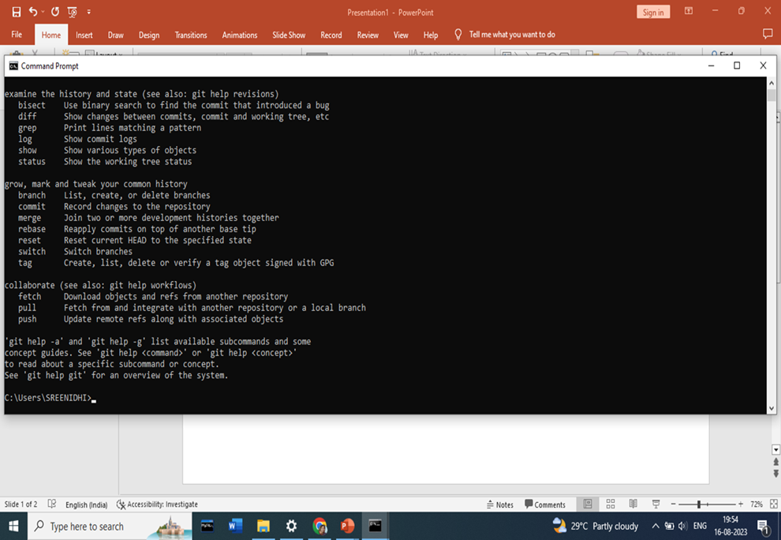
How to install Git
GitBash interface after installation

Slide 16
WHAT IS GITHUB
Github.com is a website that hosts git repositories on a remote server( i.e Cloud based hosting service)
Hosting repositories on Github facilitates the sharing of codebases among teams by providing a GUI to easily fork or clone repos to a local machine
By pushing your repositories to Github, you will pretty much automatically create your own developer portfolio as well!

Slide 17
What is the use of GitHub?
GitHub is a website where people can store and share their computer code.
It's like a big, online folder where you can keep your work, make changes, and collaborate with others.
Think of it as a place where you and your team can work on a project together, track changes, and keep everything organized.

Slide 18
Creation of Git-Hub account:
Step:-1
Browse the website https://github.com and click on Signup
Step:-2
Enter your email address with which you want to access github and also create a password for the same, select Notifications received through email—’y
Step:-3
Complete the verification process by selecting the spiral galaxy in the given set of images
Step:-4
Skip personalization …and your account is ready
Note:- Screenshots are must for each and every step and need to be uploaded into tessallator

Slide 19
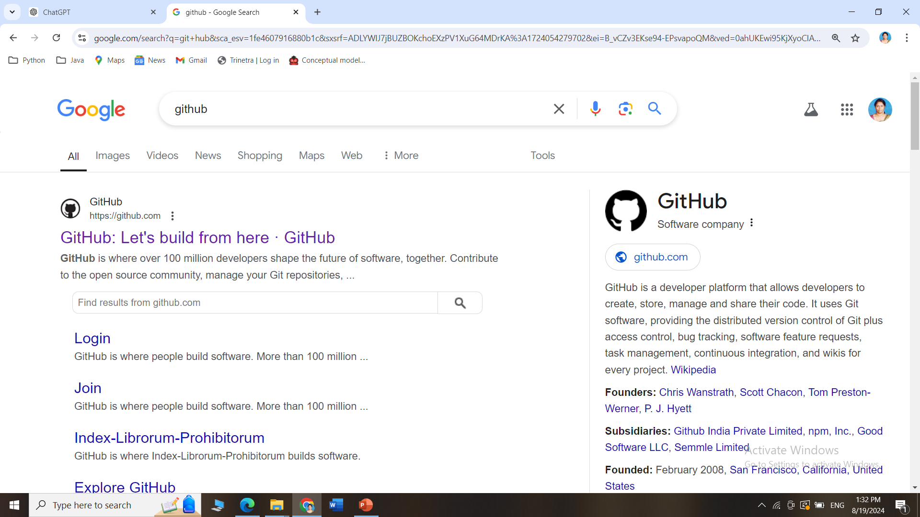
How to create an account in GitHub?
Search for github in Google and Click on the official link

Slide 20
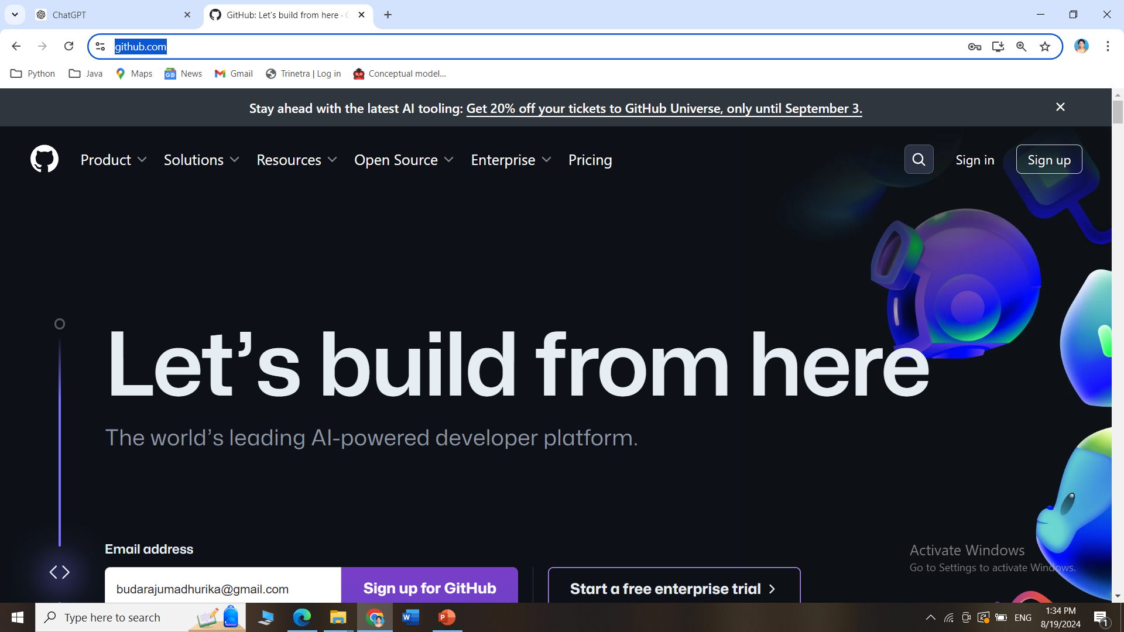
How to create an account in GitHub?
Go this site https://github.com/ and click on Sign Up

Slide 21
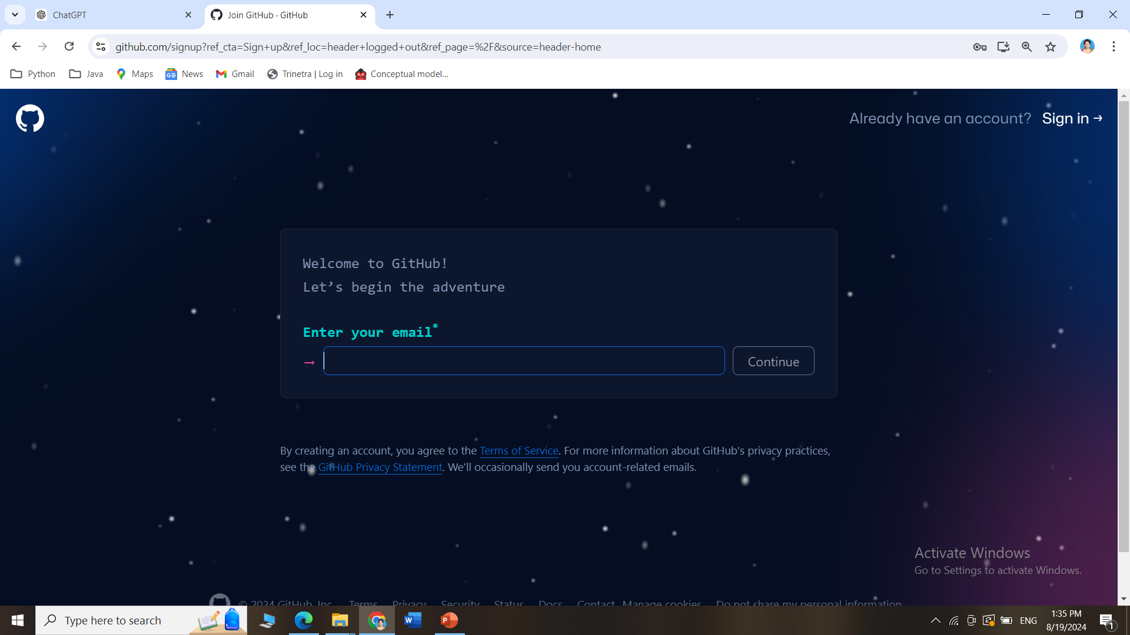
How to create an account in GitHub?
Follow the steps of Signup to create an account in GitHub

Slide 22
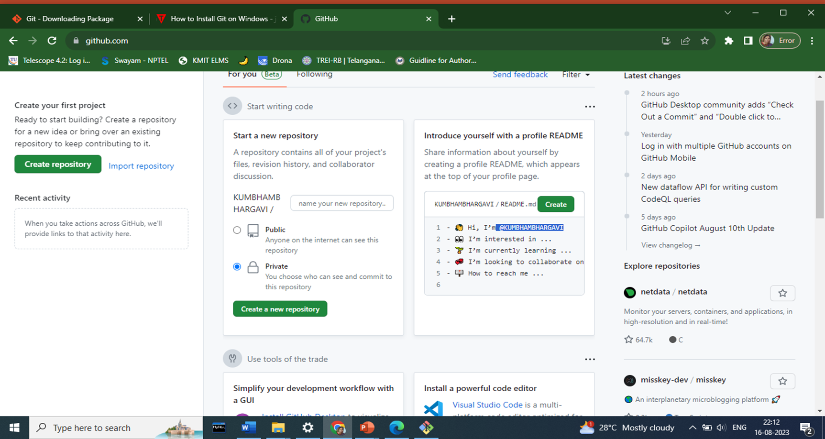
How to create an account in GitHub?
The GitHub dashboard after account creation

Slide 23
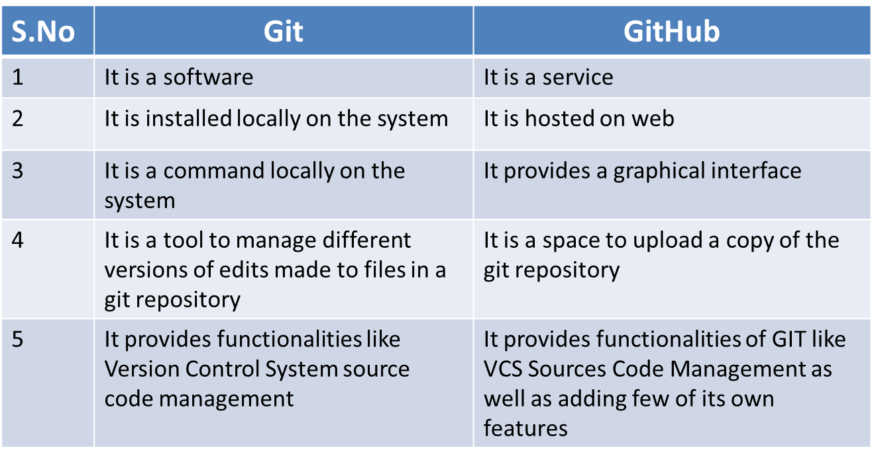
DIFFERENCE BETWEEN GIT & GITHUB

Slide 24
SRS (Software Requirements Specification)
SRS (Software Requirements Specification) is a detailed document that outlines the functional and non-functional requirements of a software system.
It serves as a blueprint for developers, stakeholders, and testers by defining how the software should behave, the features it must have, and the constraints under which it must operate

Slide 25
Star UML
Star UML is a software modeling tool used for designing and visualizing software architecture through UML (Unified Modeling Language) diagrams.
It supports various types of UML diagrams such as class diagrams, sequence diagrams, and use case diagrams, which help in planning, documenting, and communicating system designs.
StarUML is popular for its user-friendly interface and open-source nature.

Slide 26
CONTAINERIZATION & ORCHESTRATION
CONTINUOUS INTEGRATION /CONTINUOUS DEPLOYMENT:
Jenkins: A widely-used open-source automation server for continuous
integration/continuous delivery (CI/CD) pipelines
CONTAINERIZATION:
Docker: A platform for creating, deploying, and managing containers, which package applications and their dependencies in an isolated environment.
Docker container is a lightweight, isolated process running in a Docker image
ORCHESTRATION:
Kubernetes: A powerful orchestration platform for managing containers at scale, automating the deployment, scaling, and operation of containerized applications

Slide 27
BUILD TOOL
Maven: Maven defines a standardized build lifecycle with predefined phases (e.g., compile, test, package, install, deploy). You can customize or extend this lifecycle to suit specific project needs

Slide 28
MONITORING TOOL:
Nagios: A monitoring tool that collects metrics from configured targets at given intervals.
AWS (Amazon Web Services) Primarily used for Web hosting and application services
Amazon Elastic Compute Cloud (Amazon EC2) provides scalable computing capacity in the Amazon Web Services (AWS) cloud.

